Slide 1
Cloud Infrastructure Management
©22157

Slide 2
What is cloud infrastructure?
Cloud infrastructure consists of all of the hardware and software elements needed for cloud computing, including:
Compute (server)
Networking
Storage
Virtualization resources
Cloud infrastructure types usually also include a user interface (UI) for managing these virtual resources.
Infrastructure as a Service, or IaaS, is a prominent and accessible example of this model. With IaaS, a team or enterprise acquires the computing infrastructure it needs over the Internet, including computing power (whether on physical or, more likely, virtual machines), storage and plenty of related needs such as load balancers and firewalls.

Slide 3
What is cloud infrastructure management?
Cloud infrastructure management comprises the processes and tools needed to effectively allocate and deliver key resources when and where they are required. The UI, or dashboard, is a good example of such a tool; it acts as a control panel for provisioning, configuring and managing cloud infrastructure. Cloud infrastructure management is useful in delivering cloud services to both:
Internal users, such as developers or any other roles that consume cloud resources.
External users, such as customers and business partners.

Slide 4
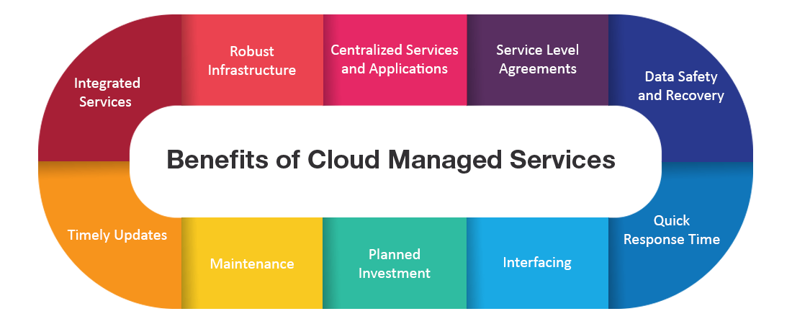
Benefits to cloud infrastructure managment

Slide 5
Why cloud infrastructure management?
Cloud infrastructure management is a must for achieving the significant promise of cloud computing overall. Properly managed and optimized, the cloud offers enterprises greater flexibility and scalability for their applications and infrastructure, while keeping costs under control. Because organizations and end users consume virtual resources via the cloud—and can even pay for these resources on an as-needed basis—they minimize the costs required to buy and maintain the physical infrastructure these virtual resources mirror.

Slide 6
Why cloud infrastructure management?
Cloud infrastructure management is a must for achieving the significant promise of cloud computing overall. Properly managed and optimized, the cloud offers enterprises greater flexibility and scalability for their applications and infrastructure, while keeping costs under control. Because organizations and end users consume virtual resources via the cloud—and can even pay for these resources on an as-needed basis—they minimize the costs required to buy and maintain the physical infrastructure these virtual resources mirror.

Slide 7
What does cloud infrastructure management do?
It enables businesses to create, configure, scale and retire cloud infrastructure as needed.
Cloud infrastructure management is like a command center or central nervous system for cloud environments.
Cloud infrastructure management allows for maximized operational flexibility and agility while maintaining cost efficiencies, by providing the capabilities needed to securely manage consolidated resources.
Without it, these distributed infrastructure models create operational complexity that is challenging for people to manage manually on their own.
Effective cloud infrastructure management allows even smaller teams to deliver web-scale services.

Slide 8
What does cloud infrastructure management do?
It enables businesses to create, configure, scale and retire cloud infrastructure as needed.
Cloud infrastructure management is like a command center or central nervous system for cloud environments.
Cloud infrastructure management allows for maximized operational flexibility and agility while maintaining cost efficiencies, by providing the capabilities needed to securely manage consolidated resources.
Without it, these distributed infrastructure models create operational complexity that is challenging for people to manage manually on their own.
Effective cloud infrastructure management allows even smaller teams to deliver web-scale services.

Slide 9
Cloud infrastructure management tools
Provisioning and configuration: Developers, systems engineers and other IT professionals use these tools to set up and configure the hardware and software resources they need. This would include:
Spinning up a new server
Installing an operating system or other software
Allocating storage resources and other cloud infrastructure needs
This also includes features for enabling and managing self-service provisioning, in which end users use a dashboard or other mechanisms for standing up their own resources as needed, based on predetermined rules.

Slide 10
Cloud infrastructure management tools
Visibility and monitoring: Cloud infrastructure management tools allow operators to “see” their environments. More importantly, they include or integrate with monitoring tools that:
Check system health
Deliver real-time alerts and notifications
Create reporting and analytics

Slide 11
Cloud infrastructure management tools
Resource allocation: Related to cost optimization, resource allocation features enable granular control over how users consume cloud infrastructure, including self-service provisioning. This is similar to budgeting: dividing up shared resources appropriately and in some cases creating criteria for going over budget.

Slide 12
Cloud infrastructure management tools
Cost optimization: Managing costs is a critical capability of cloud infrastructure management tools. Without this component, enterprises run an increased risk of “sticker shock” when the cloud bill arrives. Proactively monitoring costs via strategies such as turning off unused or unnecessary resources is key to maximizing the ROI of cloud infrastructure.

Slide 13
Cloud infrastructure management tools
Automation: Cloud infrastructure management tools sometimes offer automation capabilities for various operational tasks, such as configuration management, auto-provisioning and auto-scaling.
Security: Cloud infrastructure management tools are another part of a holistic cloud security strategy. They are one mechanism for properly configuring a cloud provider’s native security controls based on a particular setup and needs.

